Slide 1
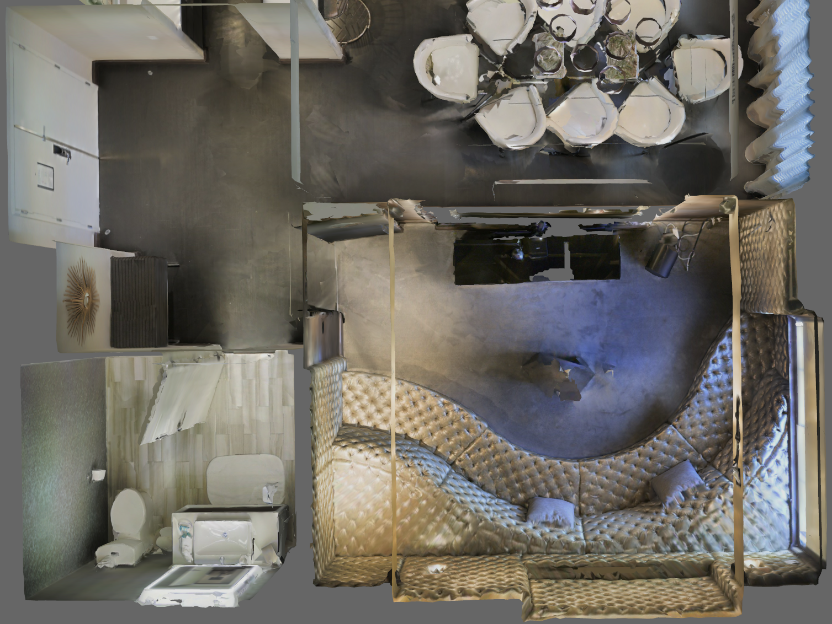
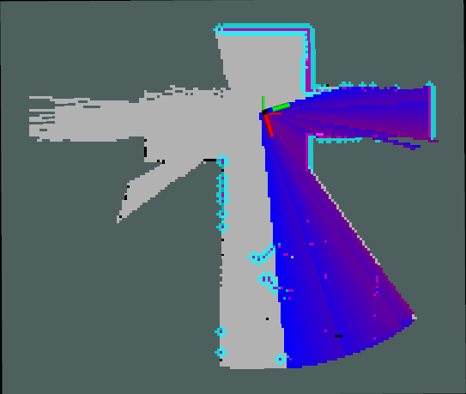
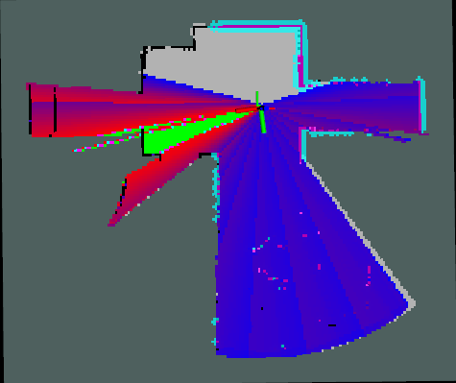
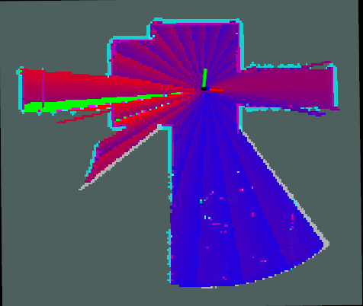
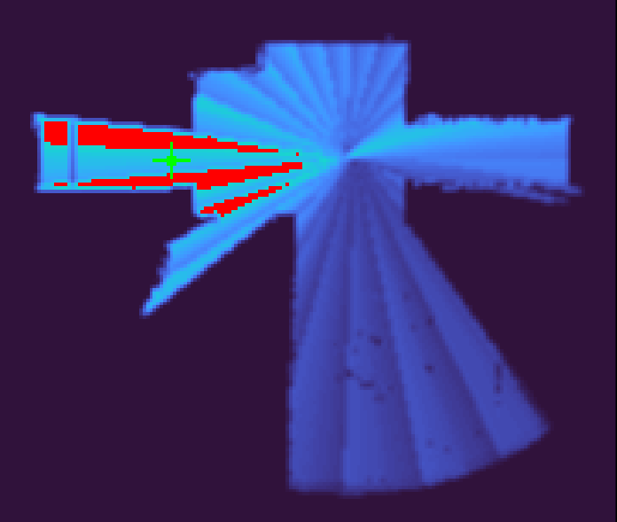
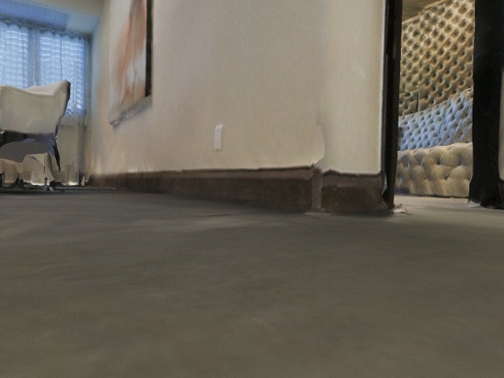
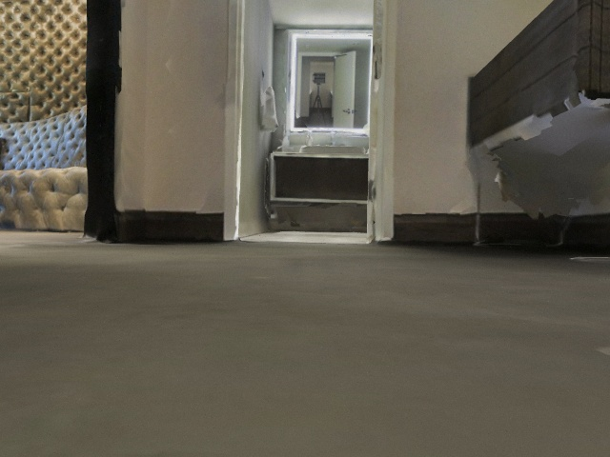
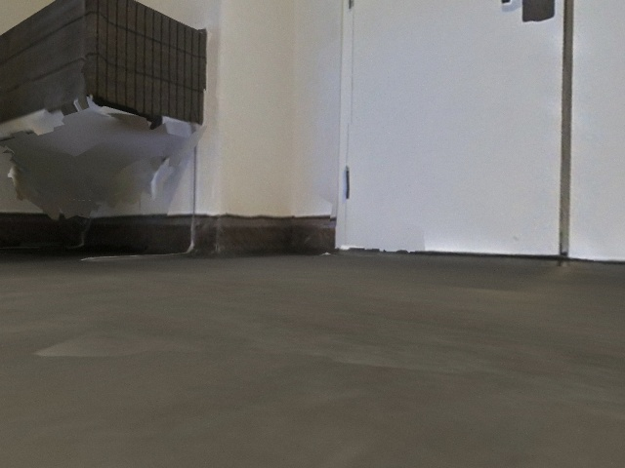
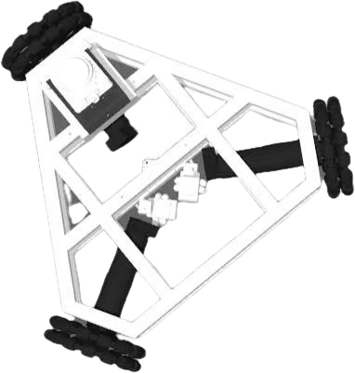
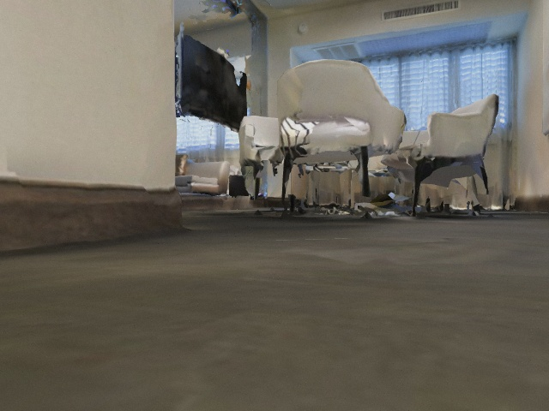
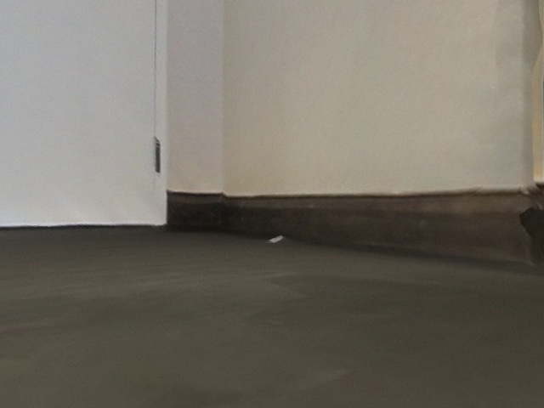
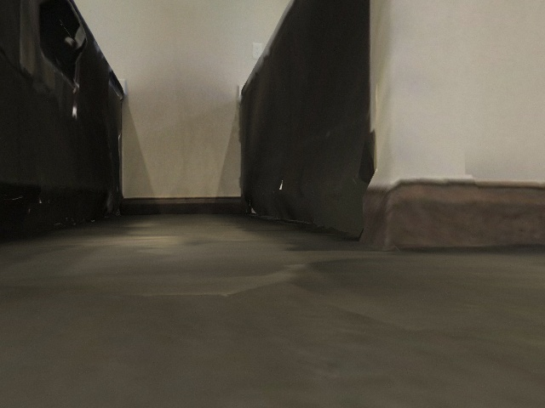
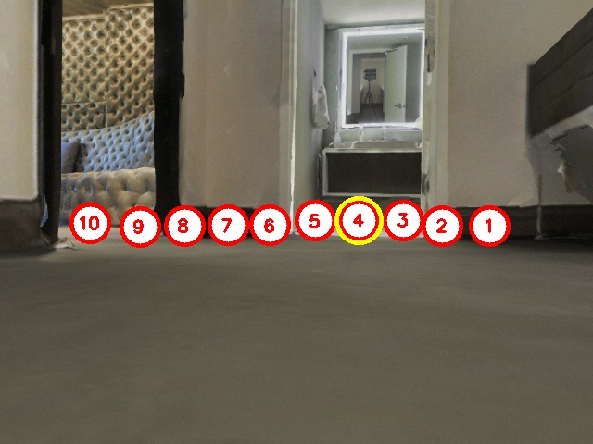
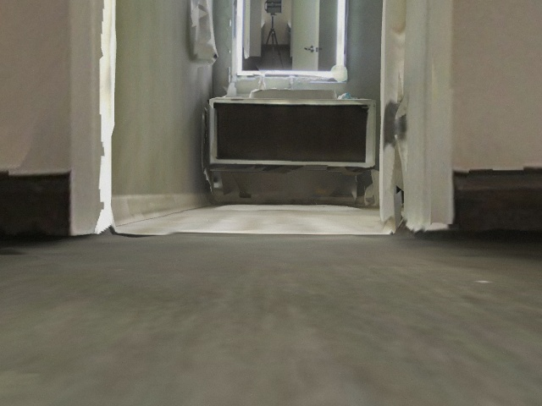
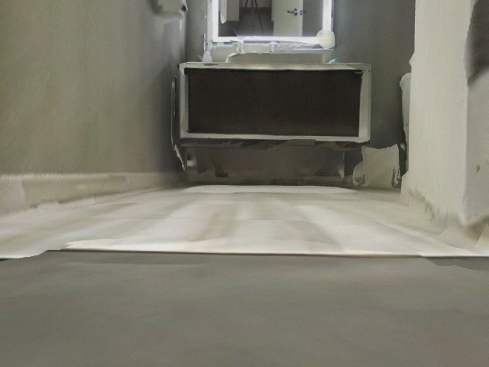
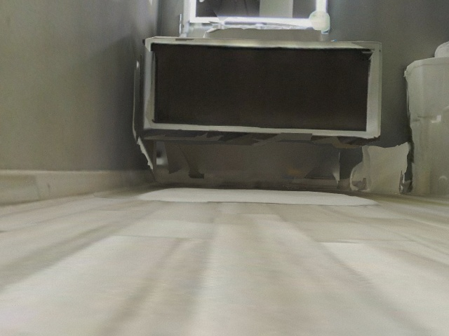
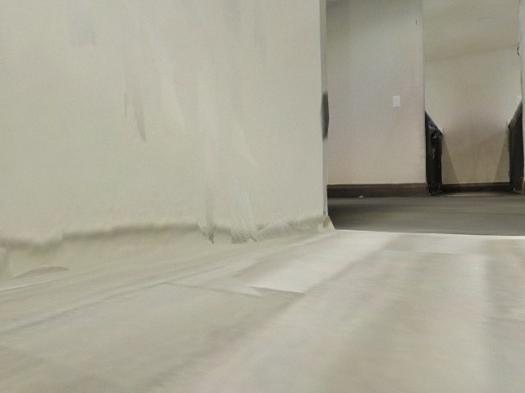
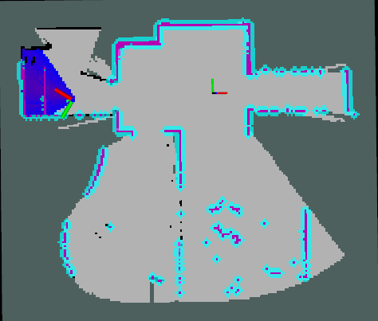
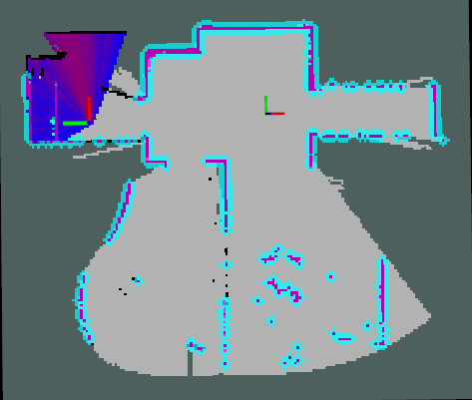
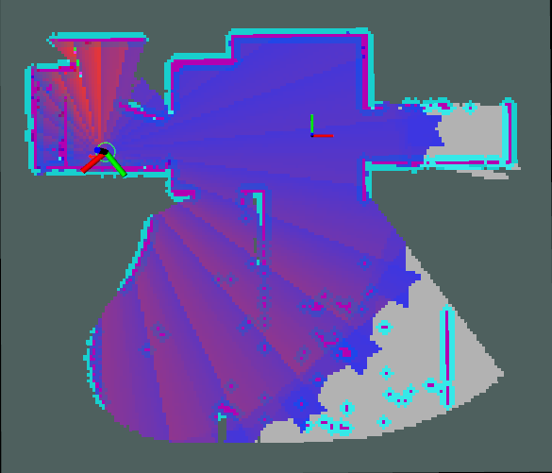
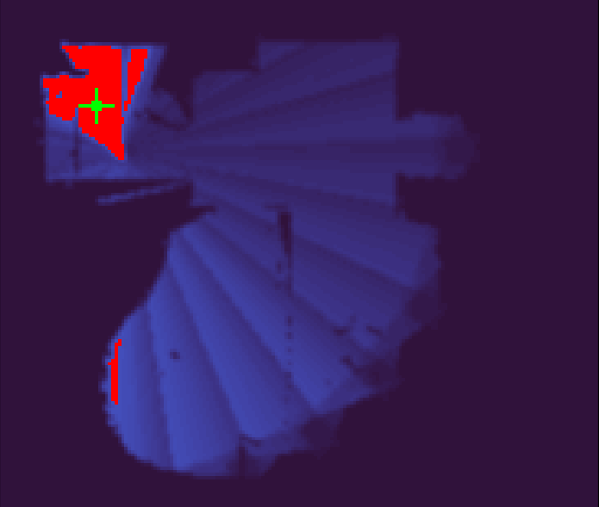
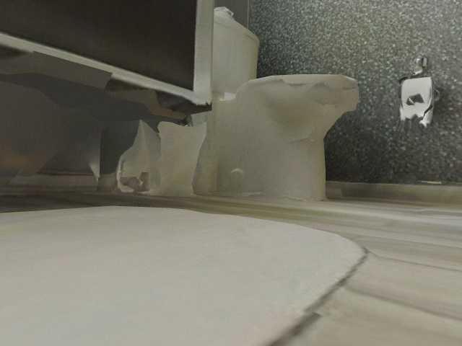
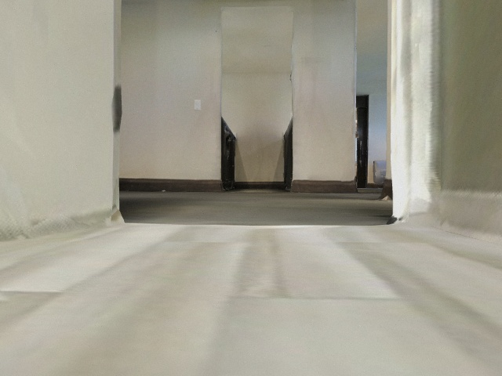
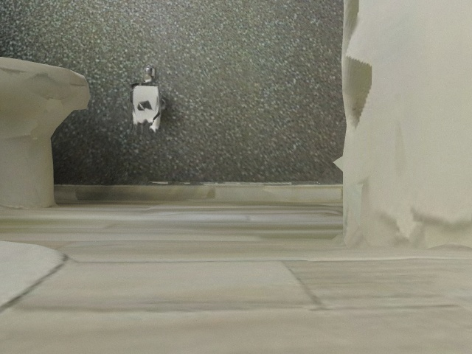
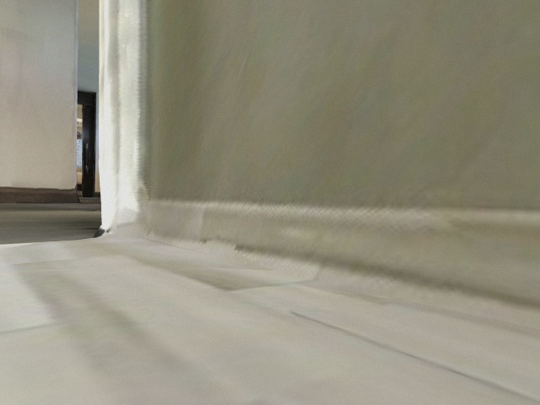
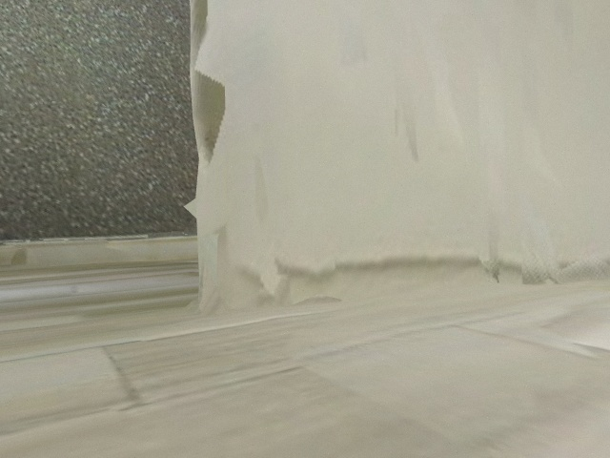
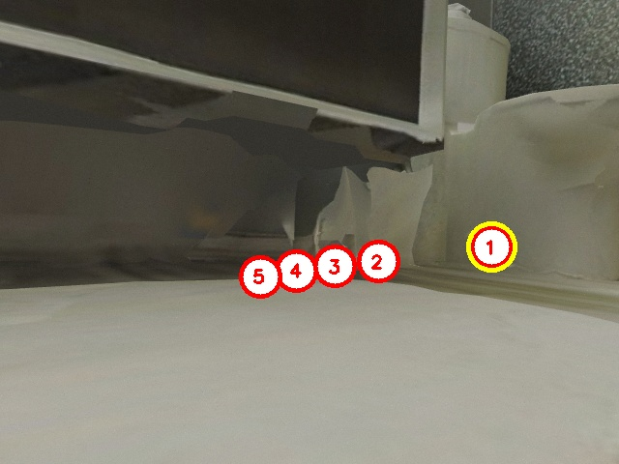
Instruction:
Go to the bathroom with an open door, and find the toilet.
Prompt Go into the bathroom
Subtask 2 Find the toilet
Subtask 1 Go into the bathroom
Subtask 2 Find the toilet
Interest score map generation
Initialization (360°Rotating)
history key frames
Waypoint navigation
Orienting to hotspot
Initialization (360°Rotating)
history key frames
Waypoint navigation
Orienting to hotspot

Slide 2
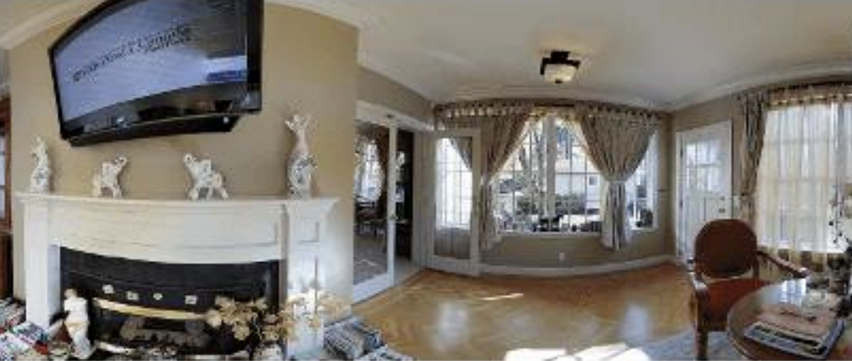
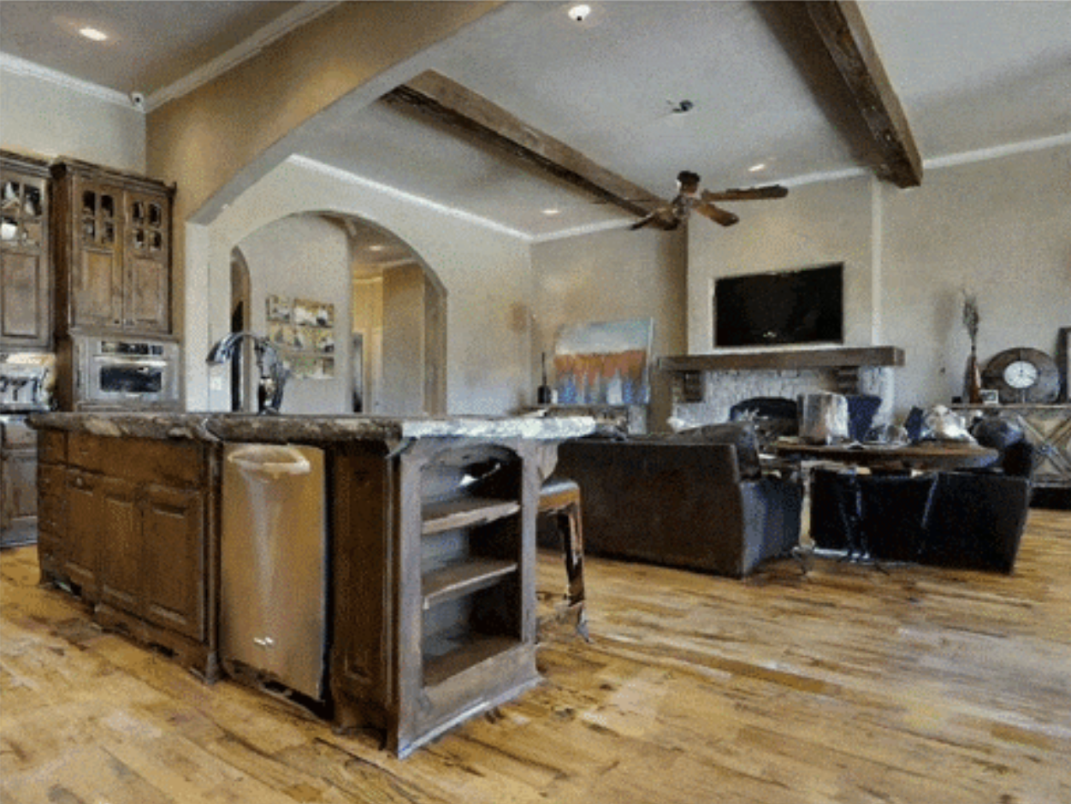
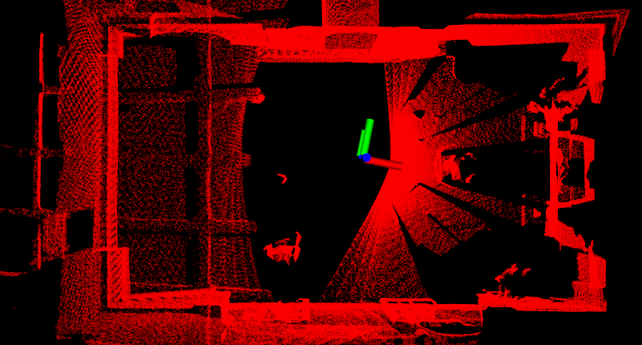
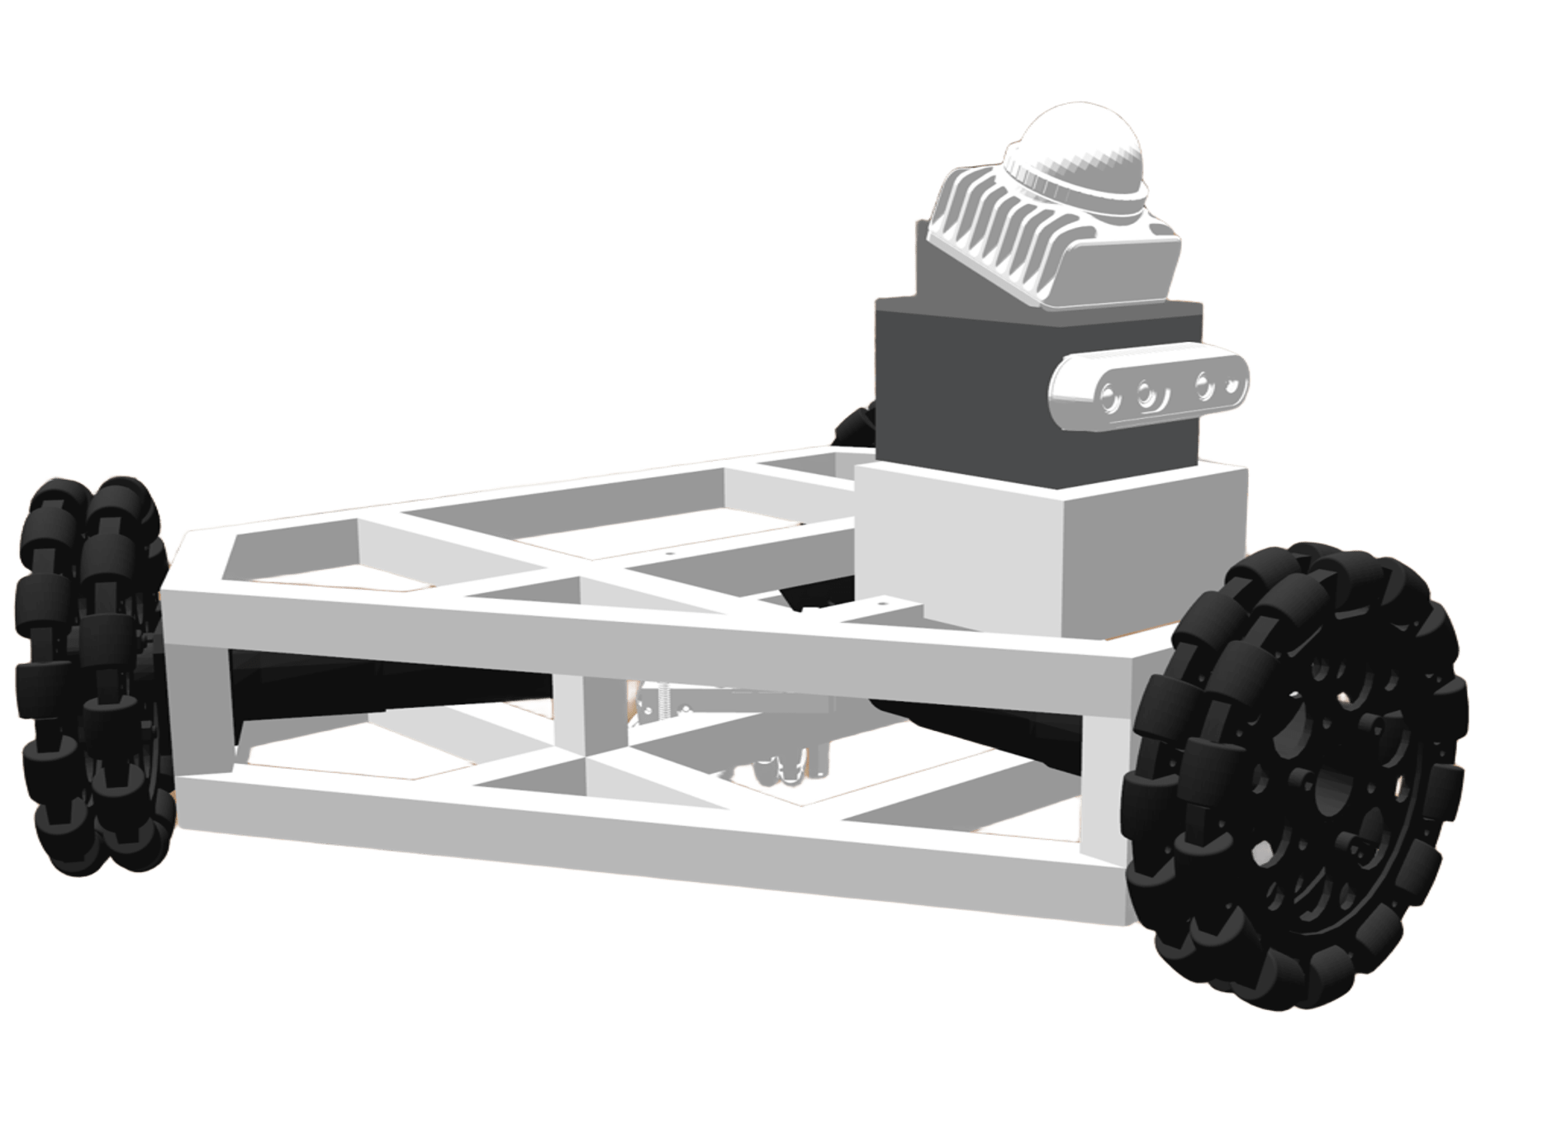
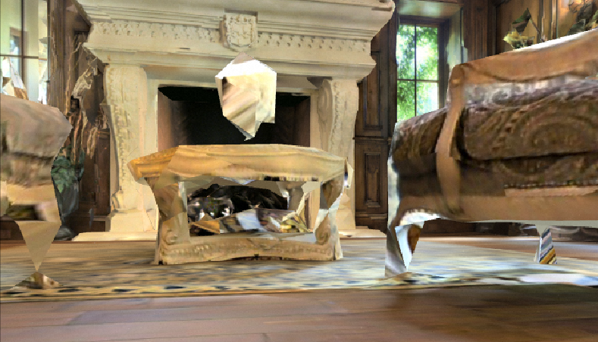
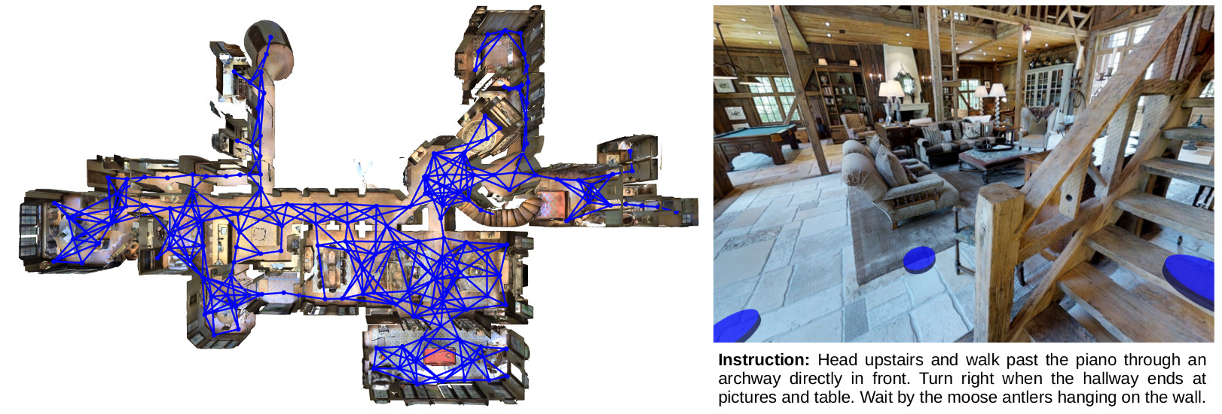
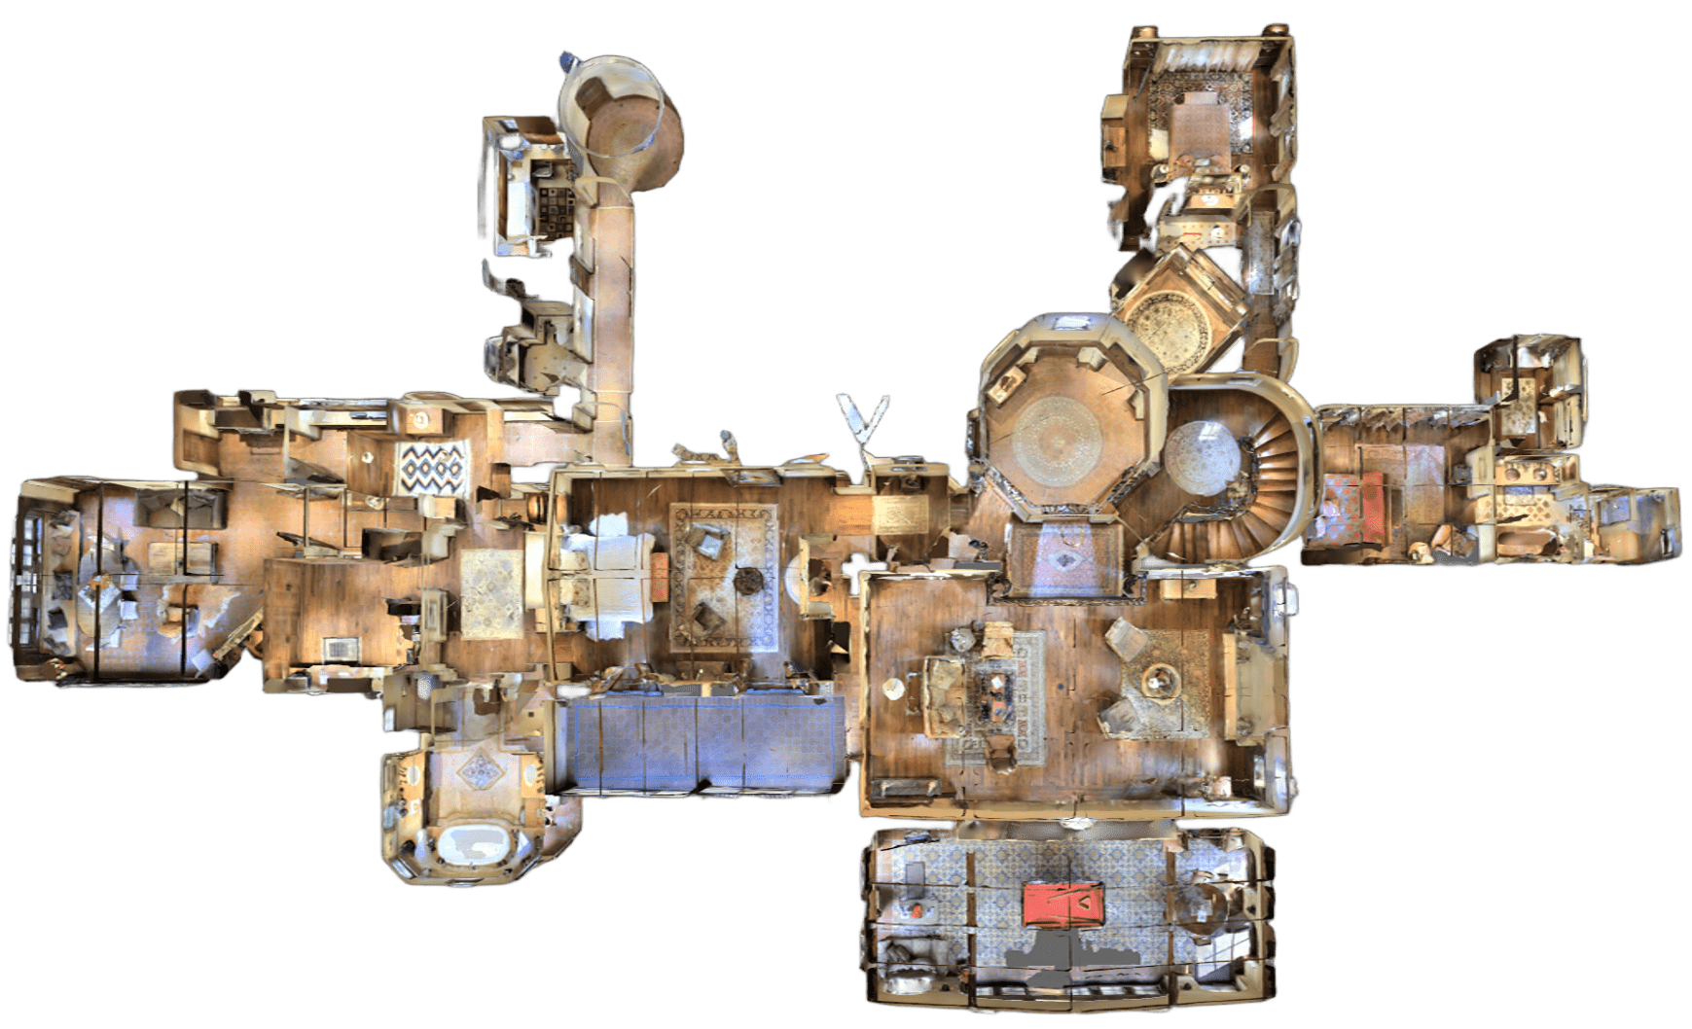

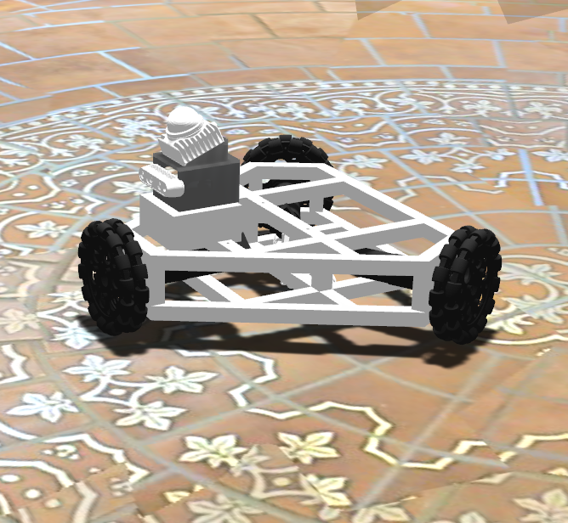
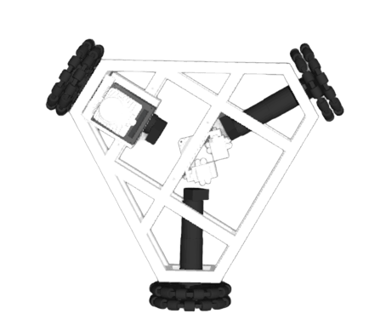
pre-recorded panoramas
rendered egocentric
simulated UGV with
real-world sensors
point cloud
camera image
forward
angular velocity
linear velocity
known topology
perfect odometry
difficult sim2real
turn left
3D simulation
perfect odometry
difficult sim2real
3D simulation
unknown odometry
easy sim2real
turn right
forward
(a) Oracle Topological Navigation
(b) Low-level Avtion Navigation
(c) ROS Waypoint Navigation Stack

Slide 3
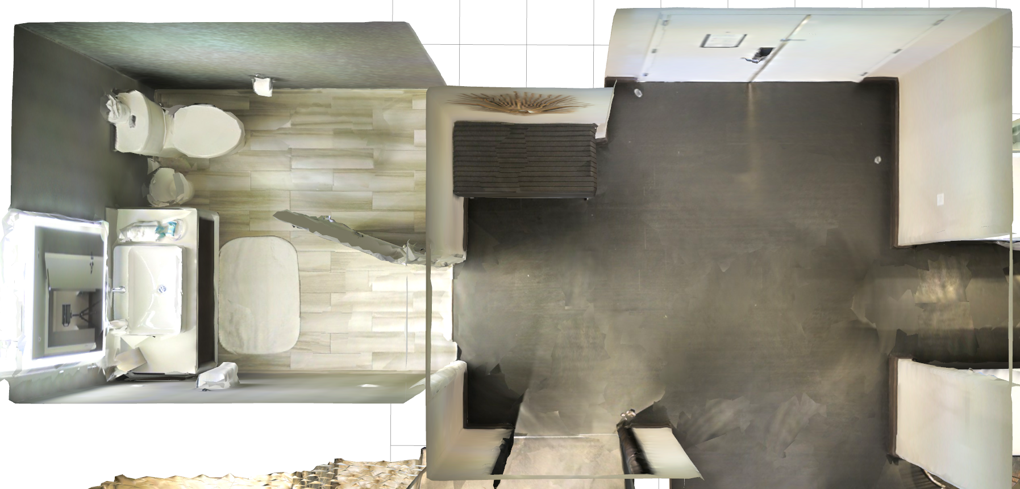
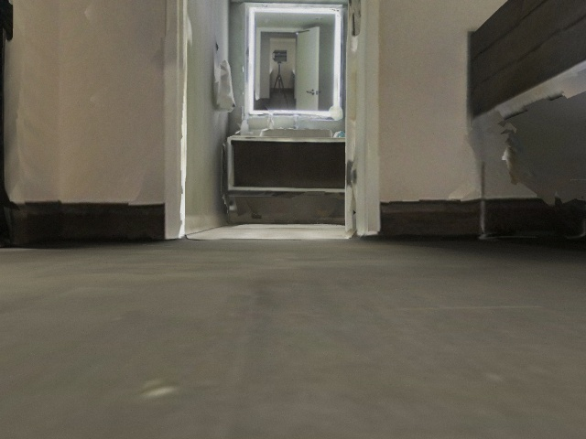
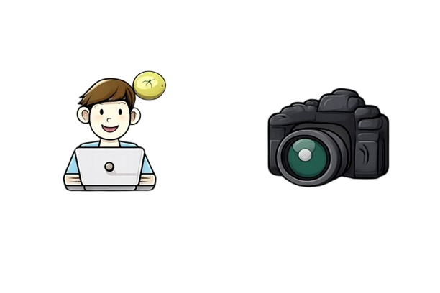
forward 1 m
forward 1 m
“Go into the bathroom with an open door, and find the toilet.”
“Go into the bathroom with an open door, and find the toilet.”
End-to-End visual-language model
Low-level robot action
forward
turn right
turn left
stop

Slide 4
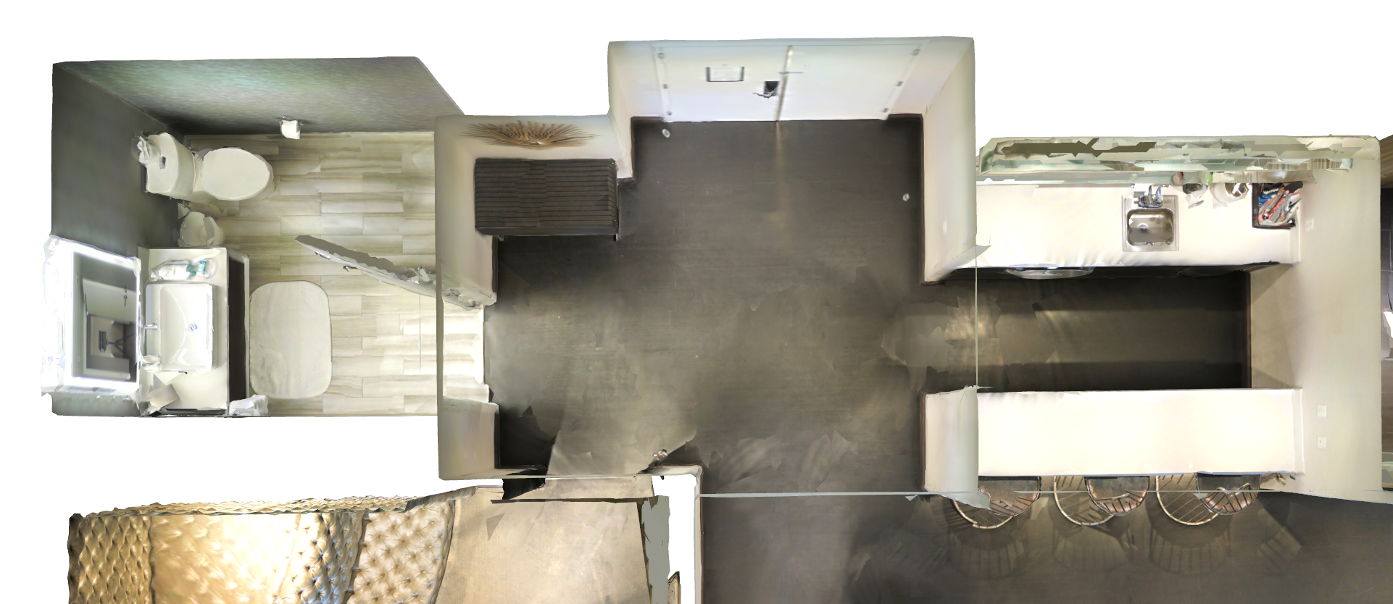


“Go into the bathroom with an open door, and find the toilet.”
“I see the bathroom. I can move forward, but I’m not sure whether I’ll run into any obstacles.”
“I can’t see the bathroom or the toilet. Where should I go?”
“I’m not sure whether I’ve entered the bathroom, and I can’t see the toilet.”
“I need to enter the bathroom first and then find the toilet.”
“I see the bathroom, and I will choose the most suitable traversable waypoint.”
“I can first look around to determine the direction of interest.”
“From the previous frames, I know I’ve entered the bathroom. Now I need to look around to find the toilet.”
Robot visual observation direction
Our VLN framework
Previous VLN framework
Human instruction

Slide 5
High level planning
Middle level grounding
“Go into the bathroom with an open door, and find the toilet.”
“I need to enter the bathroom first and then find the toilet.”

Slide 6
1
1
“Go into the bathroom with an open door, and find the toilet.”
“I need to enter the bathroom first and then find the toilet.”

Slide 7
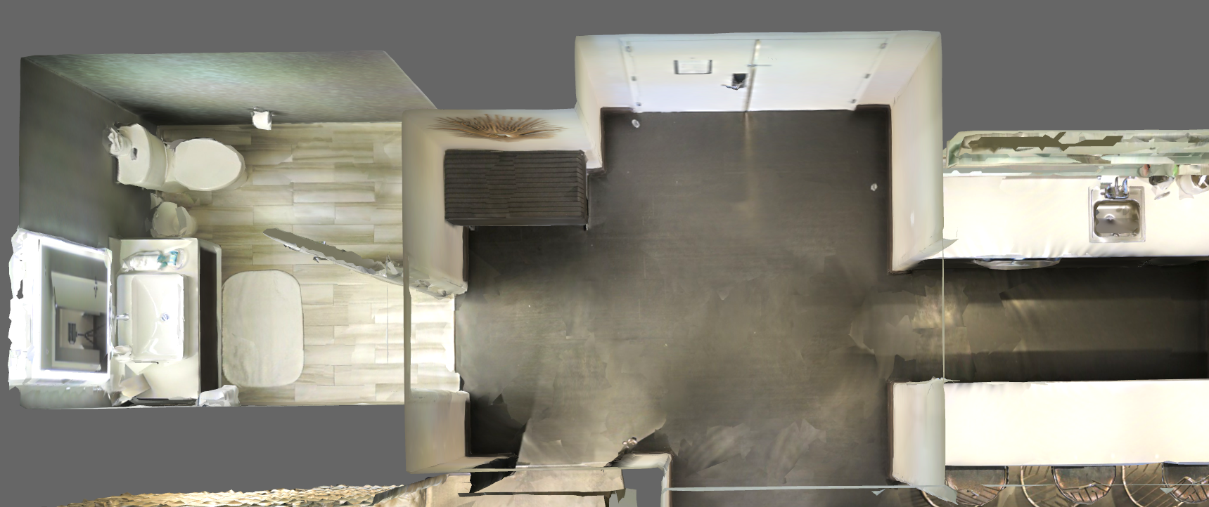
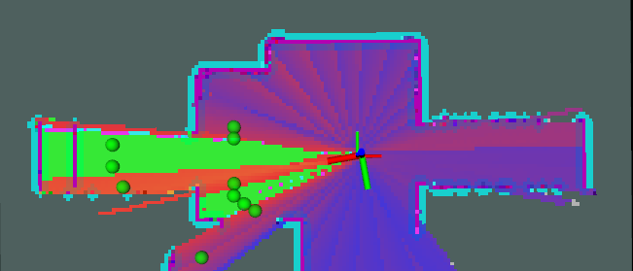
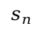
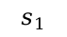
Sub-task generation
sub-task 1
Step 1: Initialization
Instruction:
Go into the bathroom with an open door, and find the toilet.
Reasoning:
sub-task 1: go into the bathroom
sub-task 2: find the toilet
360°rotating
surround view with poses
Step 3: Waypoint navigation
waypoint sample
choose waypoint
1
waypoint head
ITM head
3
2
4
6
5
7
8
$$s_{1}$$
$$s_{n}$$
9
sub-task 2
10
Waypoint navigation
...
...
Interest score map generation
Step 4: Sub-task progress reasoning
history key frames
captured during navigation
Step 2: Orienting to hotspot
Back to step3
hotspot analysis
interest score map
N
sub-task 1
Orienting to
Repeat Step1~4
task finished?
Y
plan head
Switch to
next sub-task
UGV orientation
Action execution
Change orientation
2D hotspot
UGV trajectory of sub-task 1
UGV trajectory of sub-task 2

Slide 8
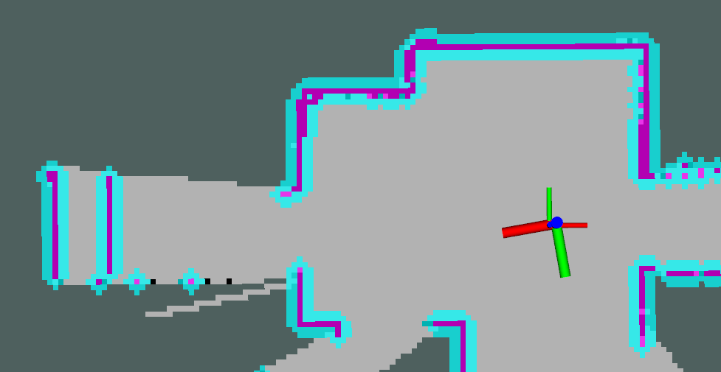
(a) High-level planning
“Go into the bathroom with an open door, and find the toilet.”
Task
planning
progress reasoning
sub-task generation
history key frames
“sub-task 1 has been completed; the next step is to execute sub-task 2.”
Sub-task 1: go into the bathroom
Sub-task 2: find the toilet
Sub-task 3: stop
Human instruction
(b) Middle-level prediction
choose waypoint
Waypoint prediction
surround view
ITM prediction
waypoint sample
1
score map generation
3
2
4
6
5
7
8
9
10
(c) Low-level UGV control
waypoint navigation
360°rotating
orienting to point of interest

Slide 9
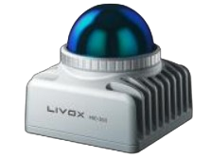
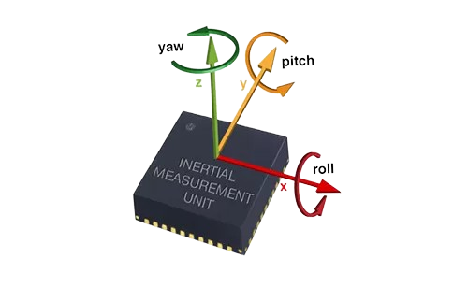
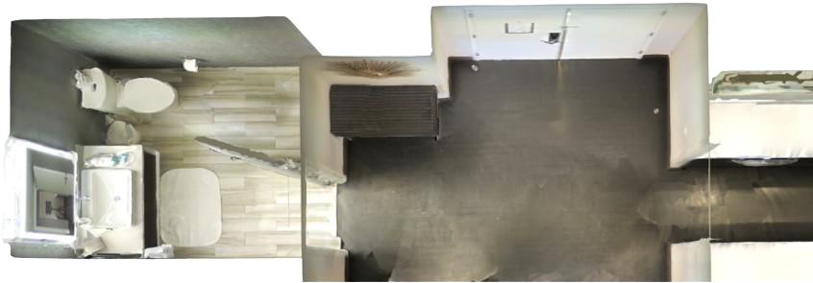
High-level planning
Low-level robot control
safe waypoint navigation
LiDAR
IMU
360°rotating
orienting to
“Go into the bathroom with an open door, and find the white toilet.”
history key frames
Progress reasoning
online odometry
“sub-task has been completed, the next step is to start next sub-task.”
Human instruction
surround view
hotspot analysis
choose traversable waypoint
“no history frames given, the next step is to start first sub-task”
Task planning
Sub-task generation
“current sub task has not been finished, the next step is to continue”
ITM prediction
waypoint sample
1. go into the bathroom
2. find the toilet
3. stop
Waypoint prediction
score map generation
1
3
2
4
6
5
7
8
9
10
Middle-level grounding

Slide 10
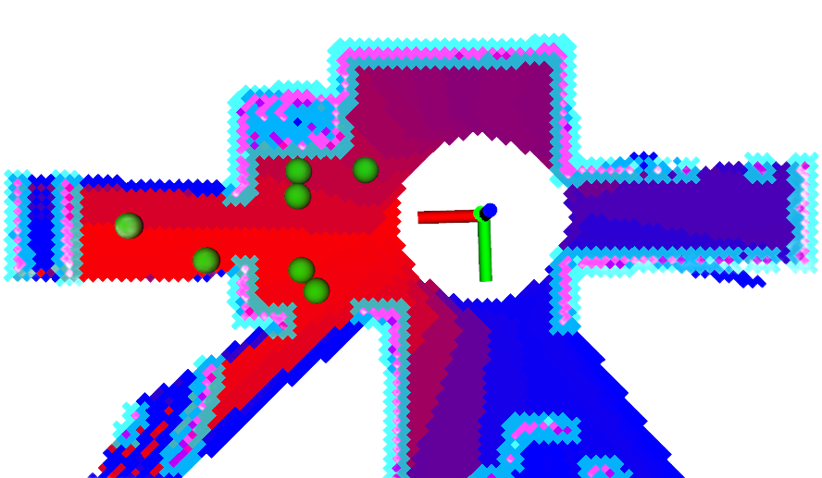


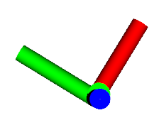

















“Go into the bathroom with an open door, and find the white toilet.”
Robot rotating to initialize the environment
Orienting toward the point of interest
Waypoint sample
Camera FoV
POI analysis
Orienting
Candiate
waypoint
Surround-view image frames
θ
(x, y)
Human instruction
Image-Text Matching (ITM)
projection
choose waypoint 4
higher
projection
bathroom with
an open door
lower
Sub-task Decomposition
1. go into the bathroom
Waypoint navigation
Optimal Waypoint Reasoning
waypoint: 1~7
Interest score map
Obstacle map
waypoint: 0, 8
2. find the white toilet
/cmd_vel
linear(x,y,z)
angular(x,y,z)
LiDAR
waypoint: -1
0:turn left
8:turn right
IMU
3. stop and wait
Online LiDAR-IMU SLAM
go to next sub-task

Slide 11














(a) Classic VLN dataset
(b) Action-to-waypoint policy
(d) Our VLN-Waypoint dataset
next four action
forward
turn left
turn right
stop
"{'Route': 0}"
instruction & route
"{'Route': -1}"
"{'Route': 3}"
"{'Route': 2}"
"{'Route': 1}"
human instruction: " Walk past the foot of the bed and exit the bedroom through the double doors ahead of you. Once out of the bedroom take a quick dogleg to the left and enter the large room with a chandelier ahead of you. "
route annotation："{'Route': 3}"
+
+
+
"{'Route': 7}"
"{'Route': 4}"
"{'Route': 5}"
"{'Route': 6}"
"{'Route': 8}"
depth image
(c) Waypoint generation
3d ground segmentation
waypoint sample
depth image & rgb image with waypoints
current frame
history frames
$$depth$$
...
RGB image
project
image with waypoints
...
$$(u,v,r,g,b)$$

Slide 12

gazebo一张step图

Slide 13









































“Go into the bathroom with an open door, and find the white toilet in the corner of the bathroom.”
steps
mapping
mapping
reasoning
mapping
mapping
reasoning
finish
observation
(a) simulation case
IsOM
higher
lower
steps
“Go into the room, and go to the blue box, and find a person wearing green shoes sitting in a chair.”
mapping
mapping
mapping
reasoning
mapping
mapping
mapping
observation
IsOM
steps
reasoning
mapping
mapping
mapping
reasoning
finish
(a) real-world case
observation
IsOM
steps

Slide 14



























Hi-Way (ours)
NaVid
A
B
A
B
A
B
A
B
Visible
success!
success!
A
B
A
B
A
A
B
Non-Visible
B
success!
fail !

Slide 15


“Trun around and go to the blue box on the ground”
steps
Hi-Way (ours)
NaVid
success!
fail !

Slide 16




Simulated camera
Hikvision CU-013
Screen
Livox Mid-360
Battery
Jetson AGX Orin
Simulated LiDAR
(a) Simulated robot setup
(b) Real-world robot setup

